Slide 1
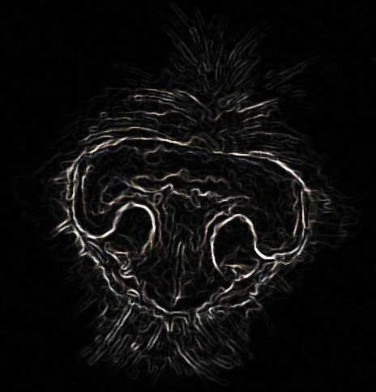
Dog Nose Recognition
Team Groza
Kim Tae Hong (20132335)
Kim Chan Il (20150577)
Paeng Jin Wook (20154645)

Slide 2
WHY?
After seeing the news that about 100,000 animals are abandoned in a year, We realized that it is serious.
And the identification of the dog will be helpful in many ways like animal hospital.

Slide 3
HOW?
Like fingerprint in human side, Dog’s nose has their own identity.
Using this, if we can find and detect special features of Dog’s nose,
we can provide their own ID.

Slide 4
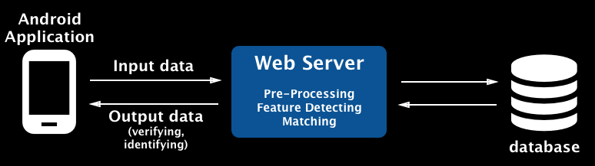
Project Architecture
We will make it available through the Android app. This will work by sending the input data to the web server, go through the process of feature detecting and matching, and returning the output to the app.

Slide 5
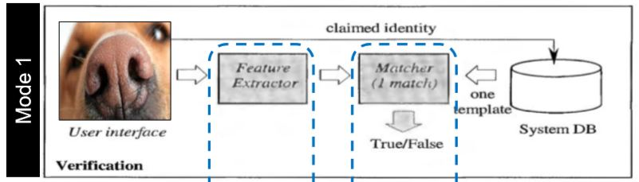
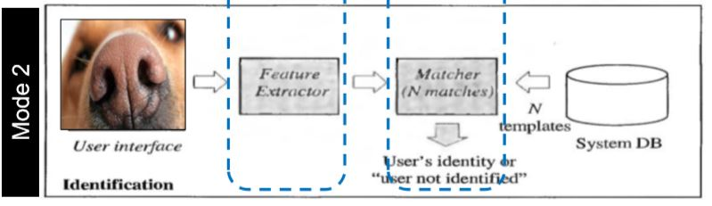
Algorithm Process
Mode 1 is a mode that can check whether your Dog or not.
Mode 2 is a mode to find out who is this dog's owner in the database.

Slide 6

Roles of Team Groza
Kim Tae Hong (20132335)
Server
Android Application Dev.
Kim Chan Il (20150577)
Application UI
database
Paeng Jin Wook (20154645)
Image Recognition
Application Dev.

Slide 7
Q&A

Slide 8
Thank You

